Slide 1
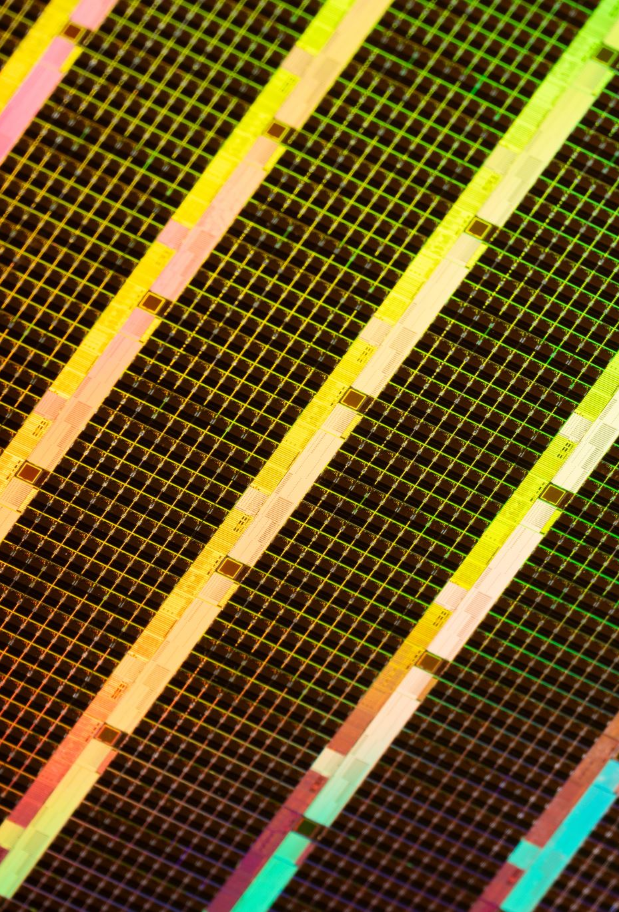
EED305 -Digital Signal Processing
Image contrast enhancement using depth and colour histograms
(IEEE Signal Processing Letters; Volume: 21, Issue: 4, April 2014)
Author : Seung-Won Jung
(Department Of Multimedia Engineering, Dongguk University, Jung-gu, Seoul, Korea)

Slide 2
Abstract:
“In this letter, we propose a new global contrast enhancement algorithm using the histograms of color and depth images. On the basis of the histogram-modification framework, the color and depth image histograms are first partitioned into sub-intervals using the Gaussian mixture model. The positions partitioning the color histogram are then adjusted such that spatially neighboring pixels with the similar intensity and depth values can be grouped into the same sub-interval. By estimating the mapping curve of the contrast enhancement for each sub-interval, the global image contrast can be improved without over-enhancing the local image contrast. Experimental results demonstrate the effectiveness of the proposed algorithm.”

Slide 3
Introduction
The general idea of image processing is to convert an image into a two-dimensional data set, and then apply methodologies/algorithms to obtain some output.
Among various contrast enhancement approaches, histogram modification-based methods have received the greatest attention owing to their simplicity and effectiveness.
Histogram equalisation technique is widely used to enhance images. Any involvement of image histograms relates directly to the contrast of the image.
In particular, since global histogram equalization (GHE) tends to over-enhance the image details, the approaches of dividing an image histogram into several sub-intervals and modifying each sub-interval separately have been considered as an alternative to GHE.

Slide 4
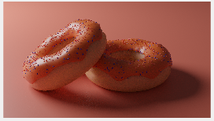
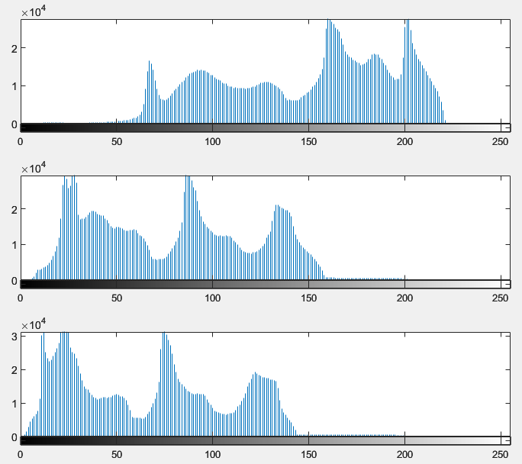
Image Histogram, what is it?
To simply define an image histogram, it is the number of pixels for a particular tone, usually a tone in the black to white spectrum. Higher the number of pixels at a given point, greater the intensity.
Here, figures (a) and (b) are the image and its corresponding histogram for the 3 basic planes, R,G,B respectively.
The Y-axis represents the number of pixels, and the X-axis represents the tonal scale, black to white (left to right)
(a)
(b)

Slide 5
Histogram Equalisation
As mentioned previously, one of the widely used techniques to enhance an image is histogram equalisation, which brings us to the question, what is histogram equalisation?
Histogram equalisation is the technique by which the dynamic range of the histogram of an image is increased. It assigns the intensity values of pixels in the input image such that the output image contains a uniform distribution of intensities.

Slide 6
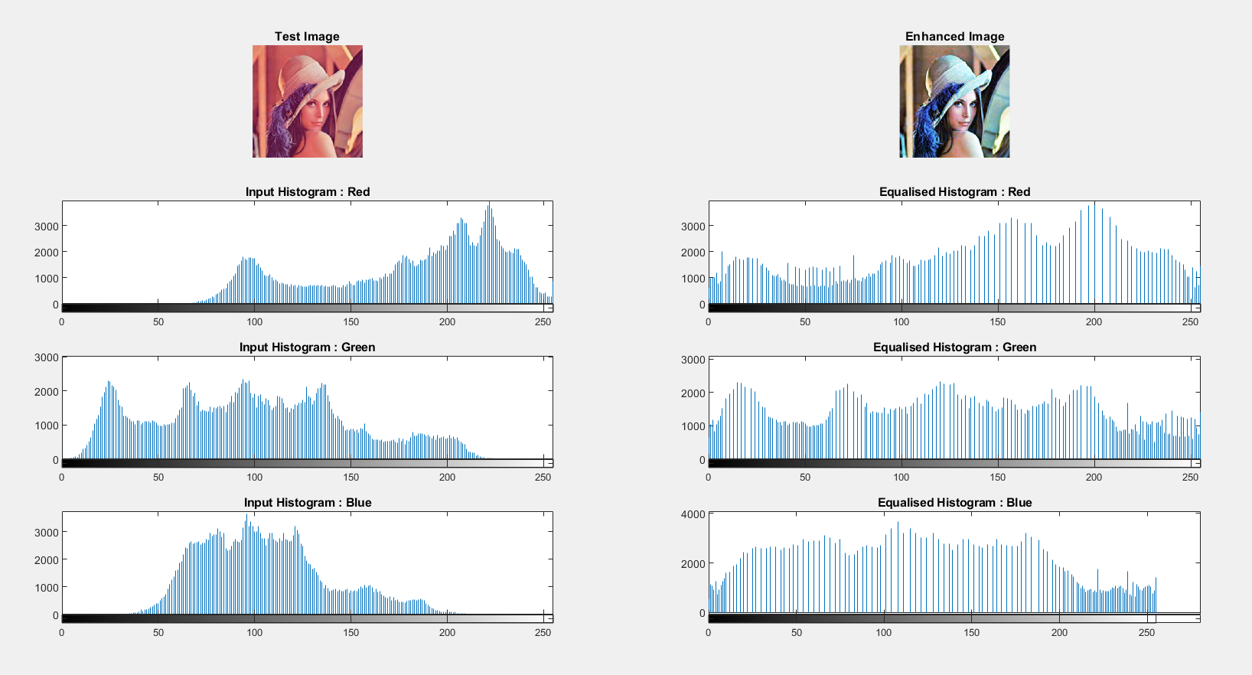
More tests

Slide 7
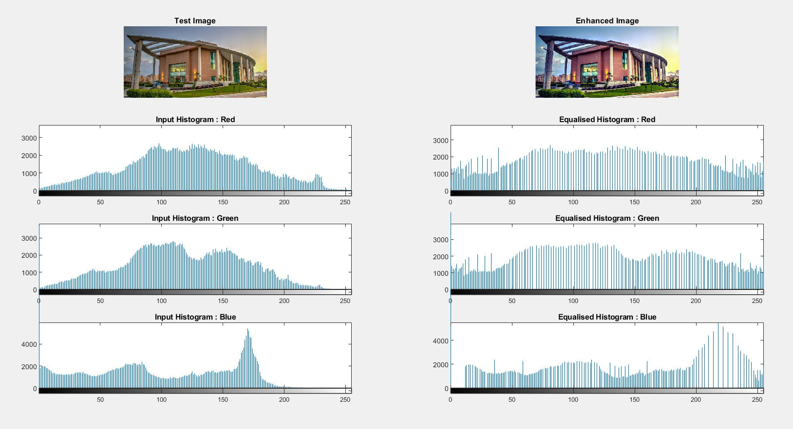

Slide 8
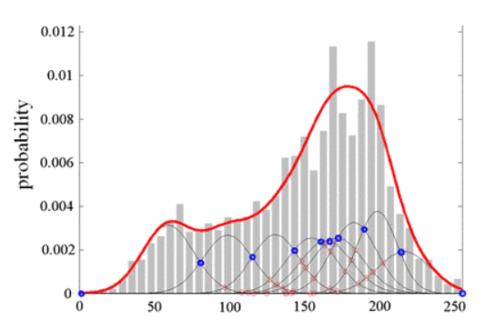
Gaussian Mixture Model (GMM)
Although histogram equalisation enhances the image, it can sometimes over-enhance the image, which can cause loss of details in an image.
One way to counter this, is to locally enhance an image. Images are represented as arrays of pixels. A pixel is a scalar (or vector) that shows the intensity (or color). A Gaussian mixture model can be used to partition the pixels into similar segments for further analysis.
Gaussian mixture models are a probabilistic model for representing normally distributed subpopulations within an overall population.
The figure on the left represents a typical GMM. The blue dots indicate the centres of the subpopulations that are considered.

Slide 9
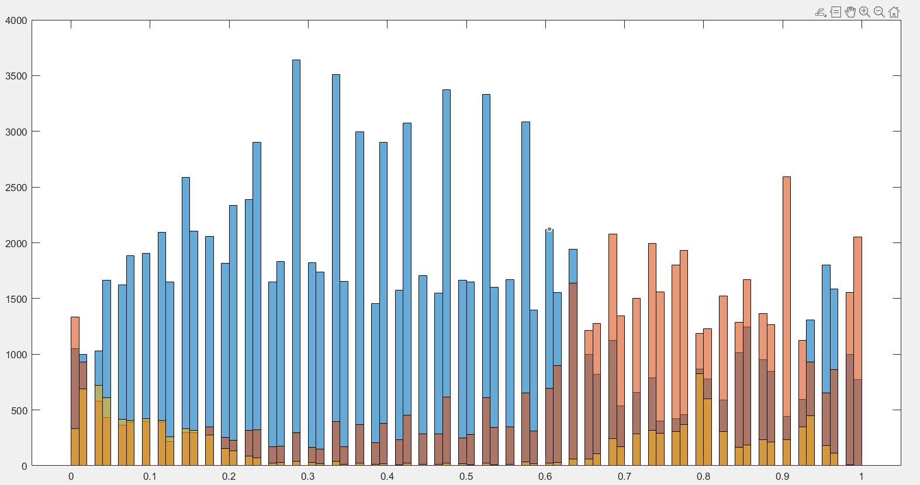
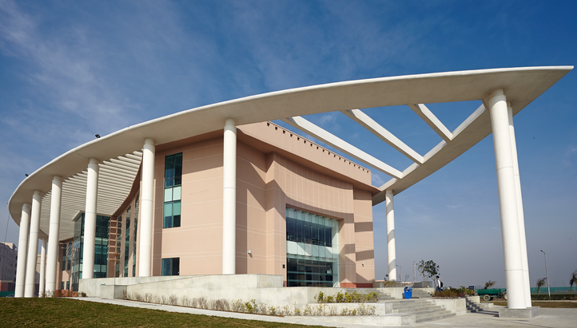
(b)
(a)
Figure (a) above represents the Gaussian mixture of the figure (b), the different colours represent different regions (local), the histogram equalises each colour, instead of equalising the entire histogram.

Slide 10
Proposed Algorithm
A pair of color and depth images are taken as input.
When representing the histogram of the color image, we transform the color space from the RGB space to the hue-saturation-intensity (HSI) space and use only the intensity channel.
The algorithm modifies the histogram of the color image using the histogram of the depth image as side information.
Histogram modification is then applied to the intensity channel, and the resultant color image is obtained by transforming the color space back to the RGB space.

Slide 11
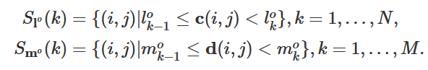
Let c and d represent the color image and the depth image, respectively.
The histograms of c and d are assumed to be divided into N and M sub-intervals, respectively, and the intersection points between the i^{th} and i+1th sub-intervals of c and d are denoted as L_{i}º and m_{i}º, respectively.
Using the intersection points, c and d can be decomposed into multiple layers as follows:
where (i,j) represents a pixel coordinate, and S_{L}º(k) and S_{m}º(k) are the sets of pixels in the k^{th} layer of c and d, respectively. L₀º and I_{N}º are the start and end positions corresponding to the first and last sub-intervals, respectively, and m₀º and m_{M}º are defined similarly.
Pixels with the same color belong to the same layer.

Slide 12
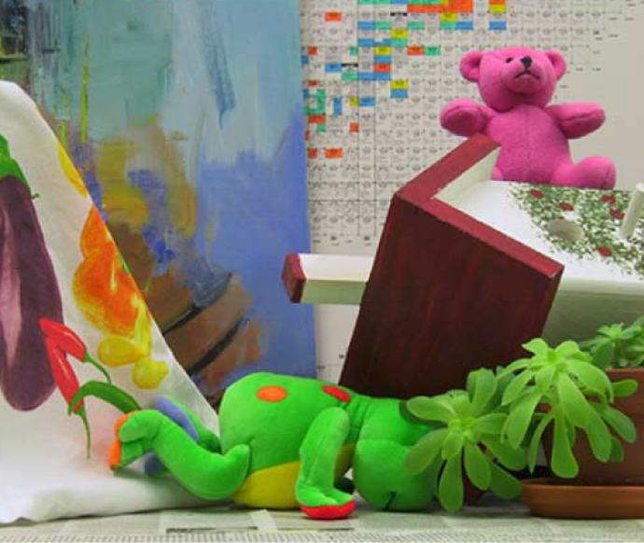
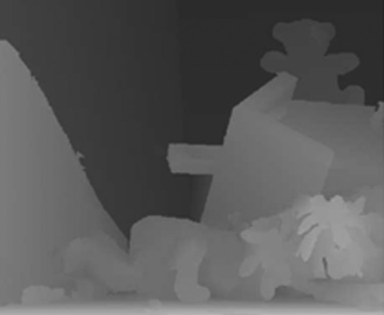
Depth Image
Another way to distinguish data for an image is to take its depth image.
Depth image gives you the “depth” of the object or the “z” information of the object in real world. The intensity values in the image represent the distance of the object from a viewpoint. One can visually represent ‘close’ and ‘far’ objects using a depth image
Figure (a) – Colour image
Figure (b) – Depth image
(a)
(b)

Slide 13
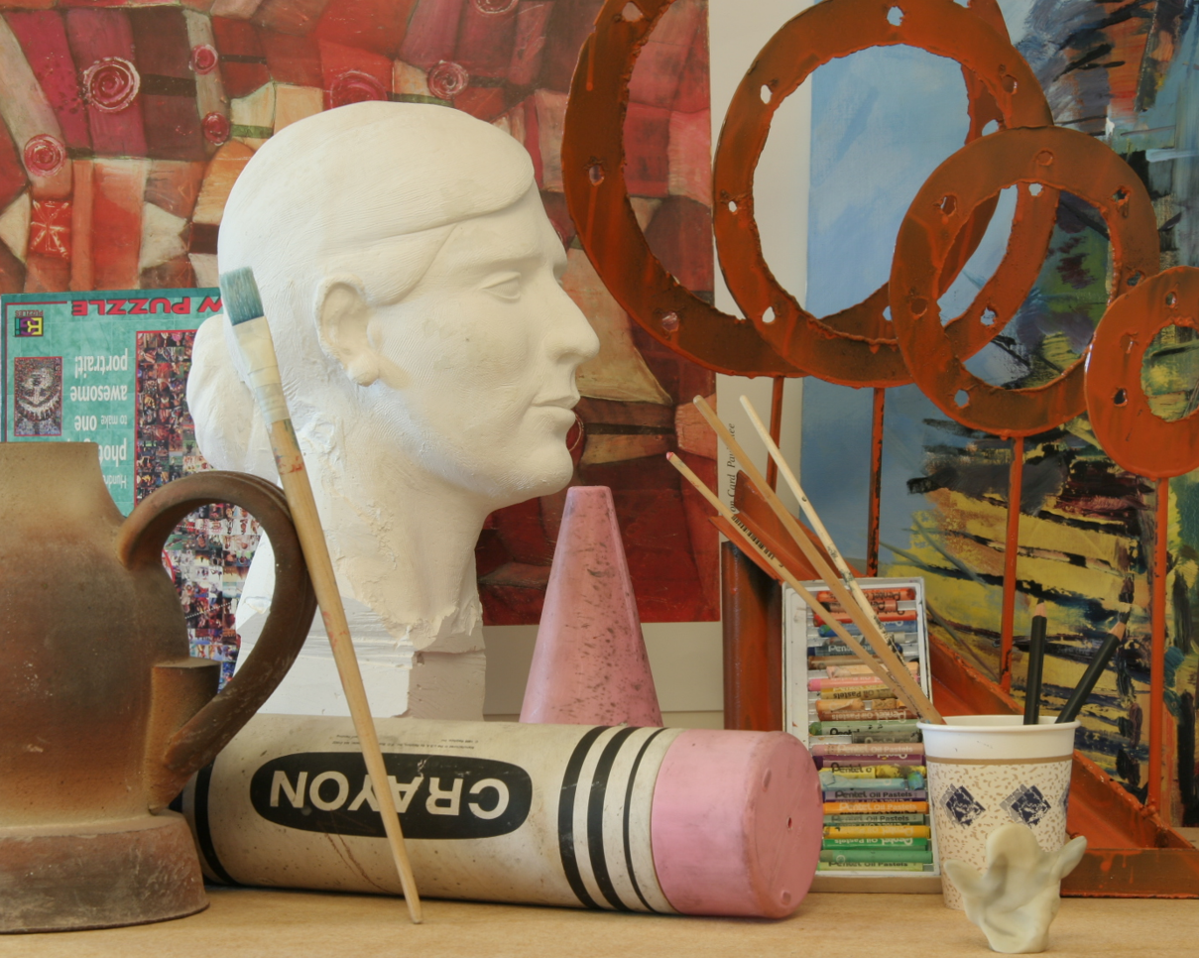
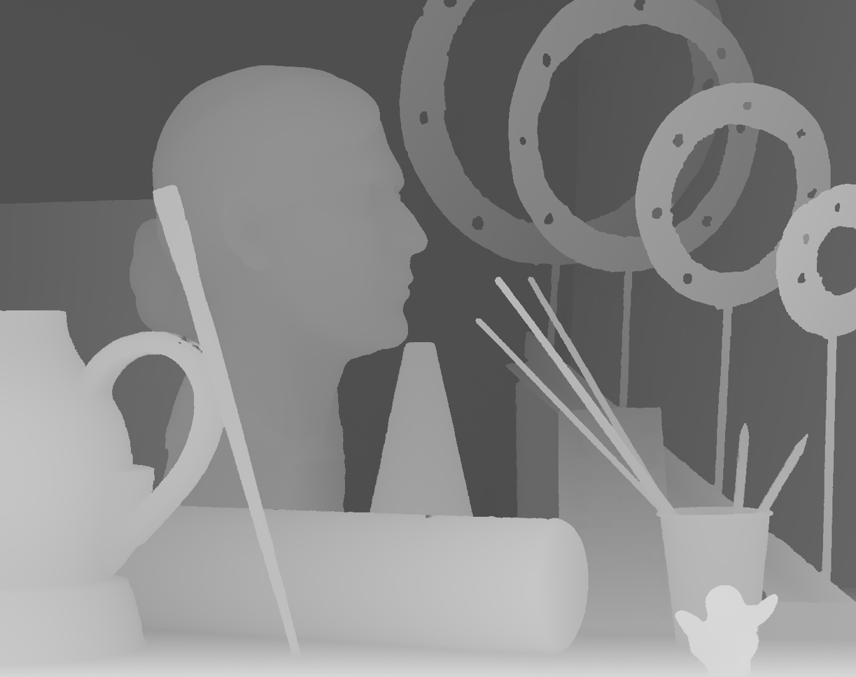
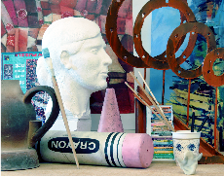
Obtaining the depth image
Obtaining the enhanced image

Slide 14
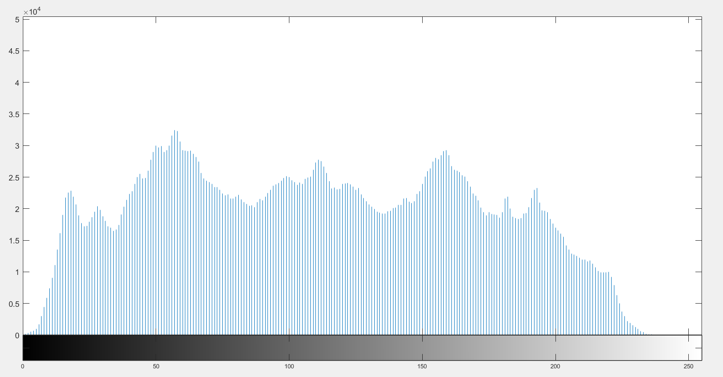
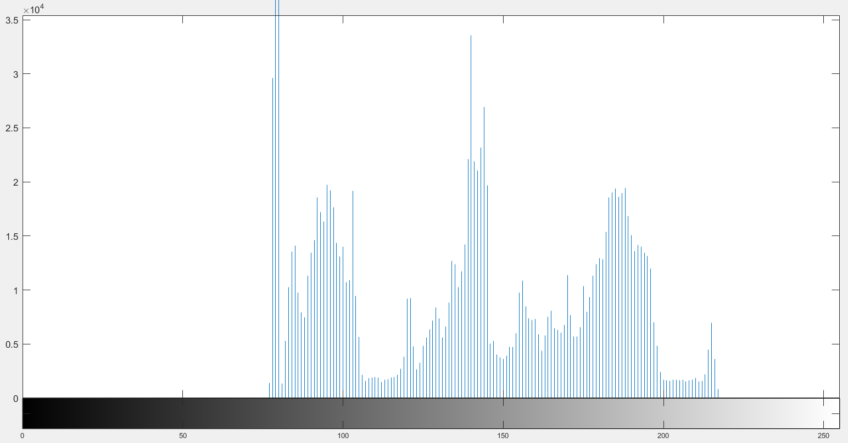
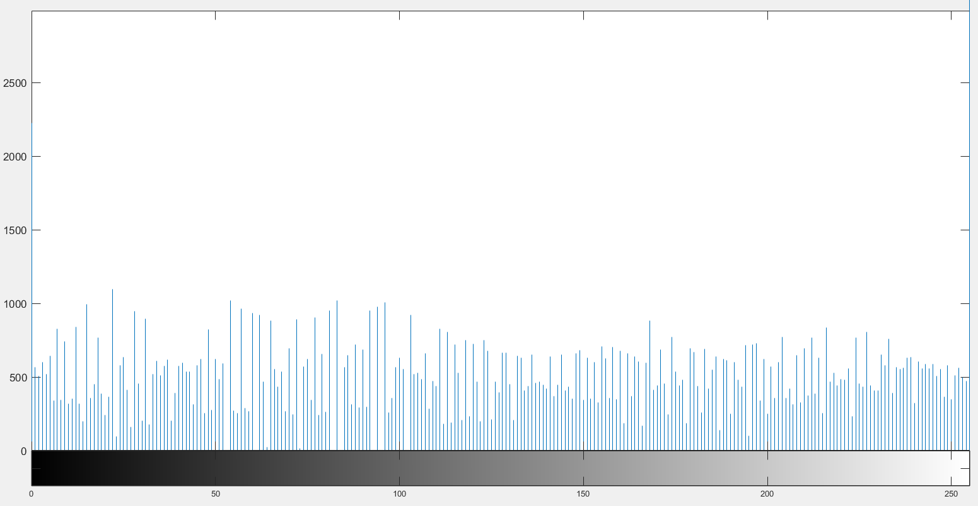
Histogram of the original image
Histogram of the depth image
Histogram of the enhanced image

Slide 15

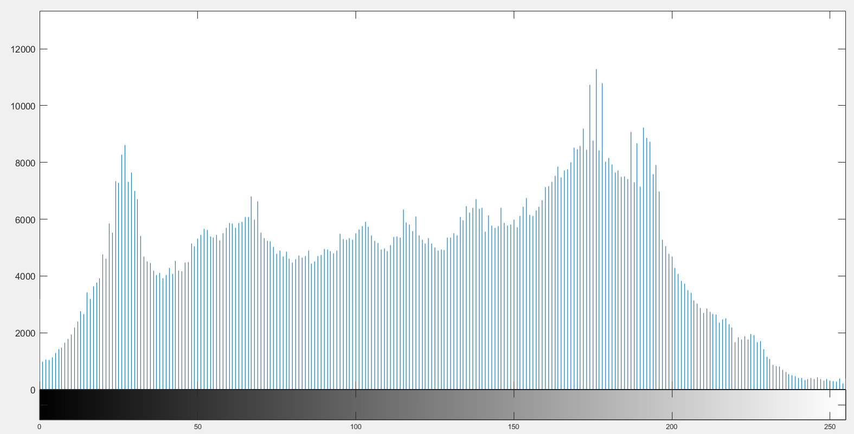
Test Image #2
Figure (left) and its corresponding histogram (right)

Slide 16
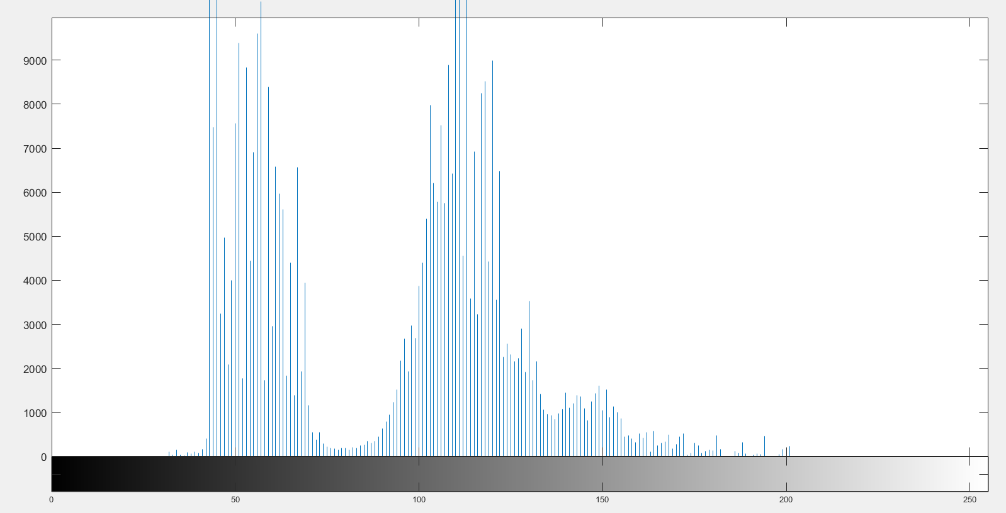
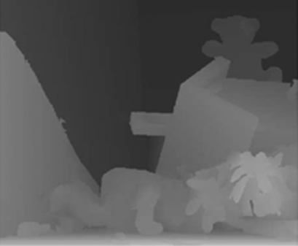
Depth image of figure (left) and its corresponding histogram (right)

Slide 17
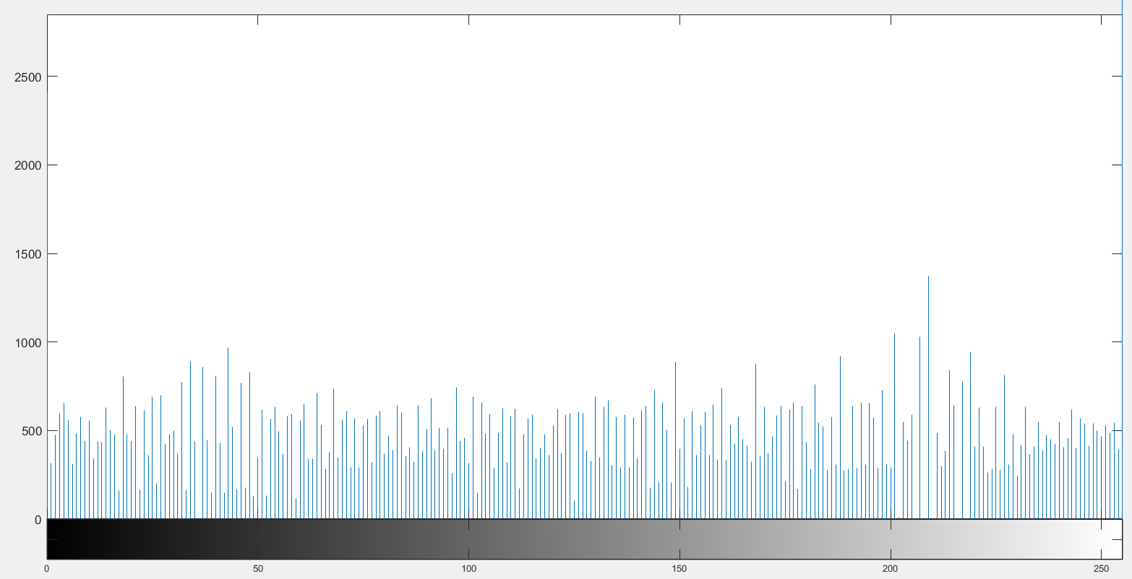
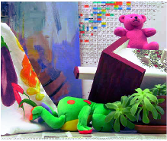
Enhanced image (left) and its corresponding histogram (right)

Slide 18
Conclusion
Histogram equalisation is an intuitive and widely used technique to obtain contrast enhanced images for further analysis. It highlights details previously not visible.
However it can over-enhance images especially if the boundaries are of similar colours (intensity).
In such cases, just histogram equalisation is not enough. With the use of GMM and depth histograms, one can accurately enhance those regions which are sensitive and then overall obtain an enhanced image as per requirements.

Slide 19
Conclusion
Image regions with similar intensity and depth values are decomposed into different groups.
By using the proposed algorithm, such regions were merged into the same layer.
This prevents over-enhancement of the specific layers, thus preventing over-enhancement of the overall image.

Slide 20
References
https://ieeexplore.ieee.org/document/6727422
https://ieeexplore.ieee.org/document/6247827
https://www.researchgate.net/publication/261303306_An_improved_Non-Local_Cost_Aggregation_method_for_stereo_matching_based_on_color_and_boundary_cue#pf6
https://brilliant.org/wiki/gaussian-mixture-model/
https://jakevdp.github.io/PythonDataScienceHandbook/05.12-gaussian-mixtures.html
https://towardsdatascience.com/histogram-equalization-5d1013626e64
https://ieeexplore.ieee.org/document/5957283

